Slide 1
Cloud Computing: SOA Design Patterns, Part I
Vijay Dialani, PhD
Boise State University
vijaydialani@boisestate.edu
©All rights reserved by the author

Slide 2
What are Design Patterns?
Software Design Patterns - Wikipedia
In software engineering, a design pattern is a general reusable solution to a commonly occurring problem within a given context in software design. A design pattern is not a finished design that can be transformed directly into source or machine code. It is a description or template for how to solve a problem that can be used in many different situations.

Slide 3
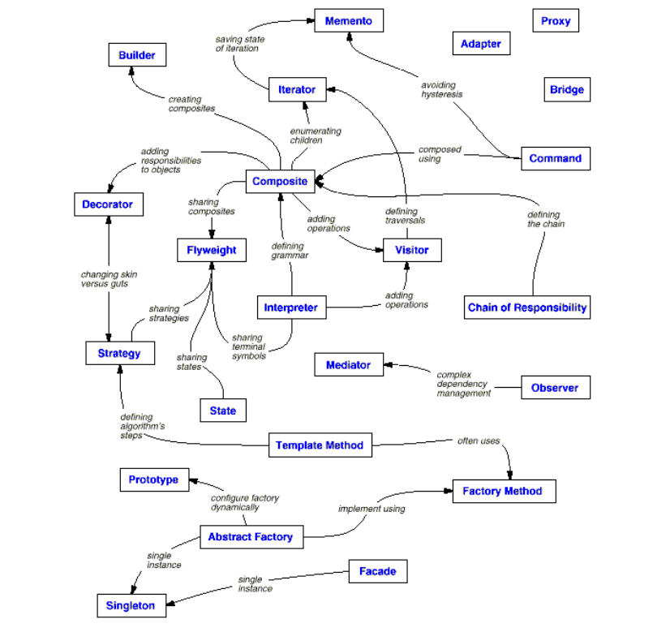
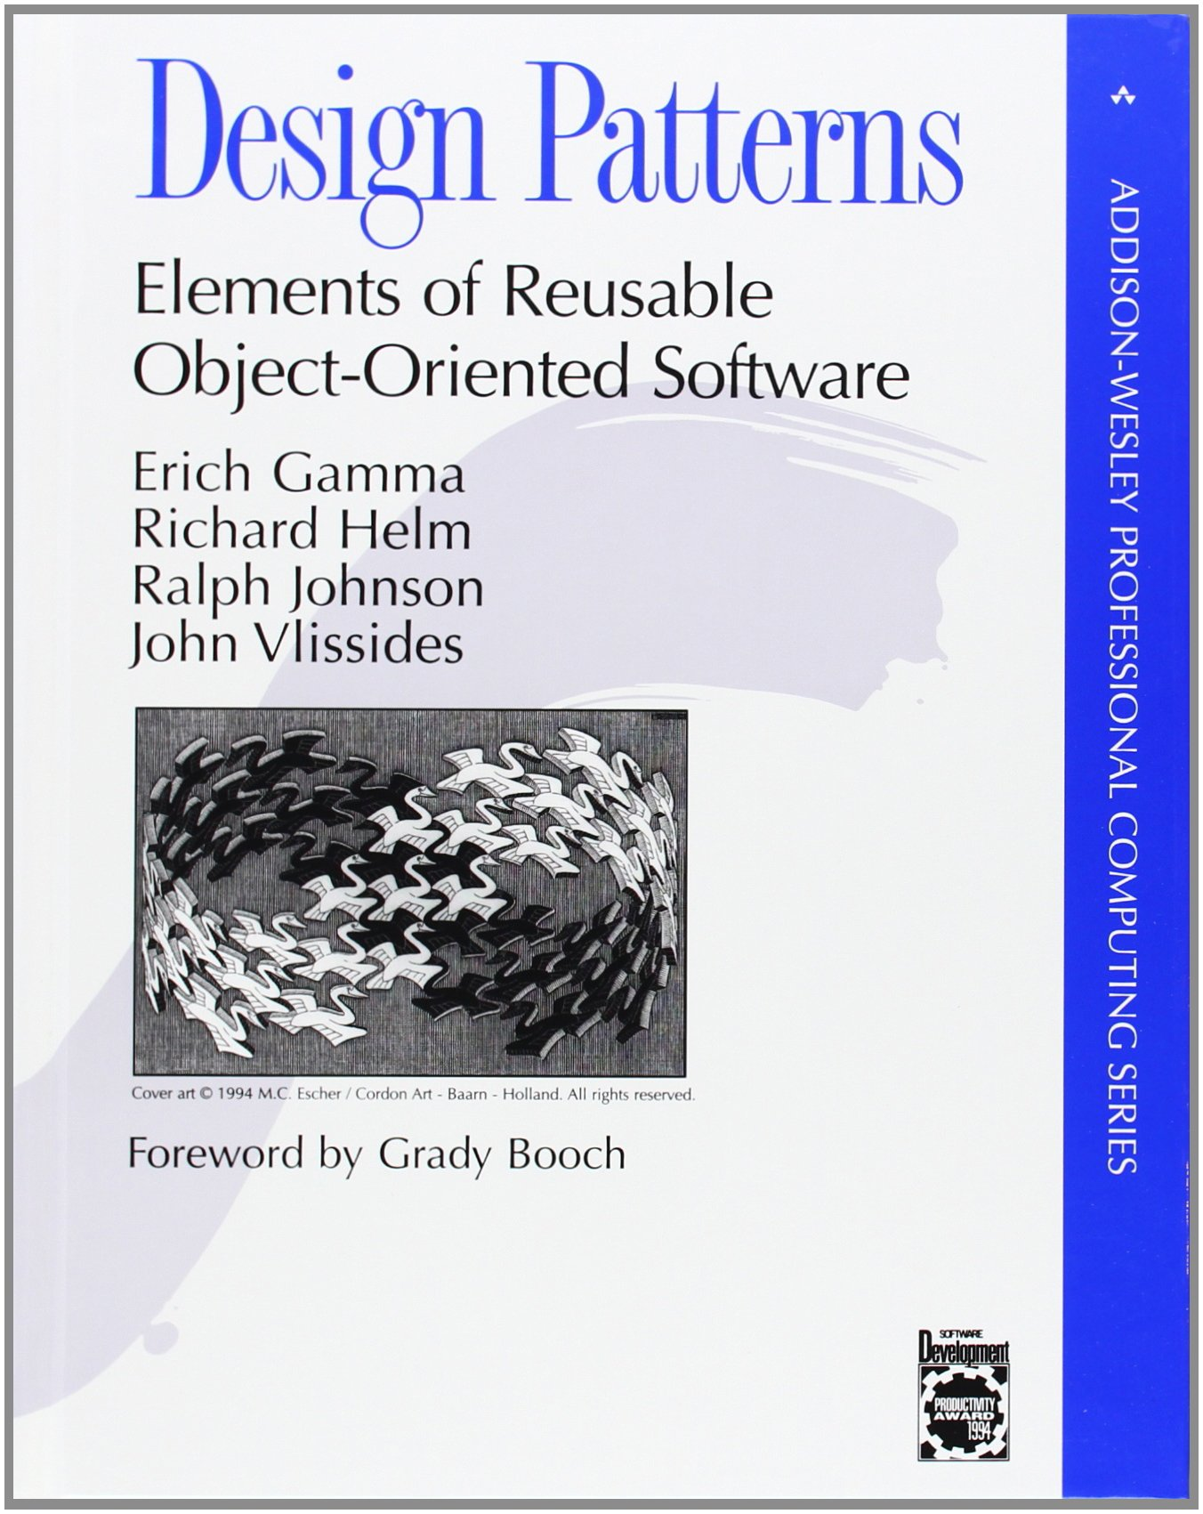
Software Design Patterns

Slide 4
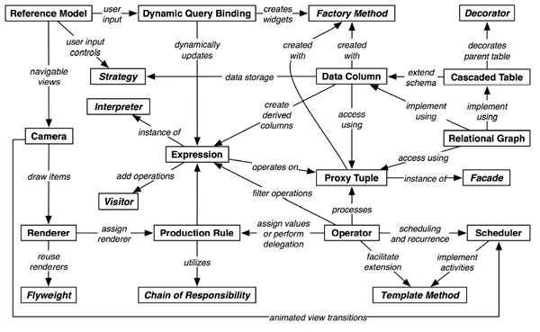
Softawre Design Patterns for Information Visualization
@article{2006-infovis-design-patterns, title = {Software Design Patterns for Information Visualization},
author = {Jeffrey Heer AND Maneesh Agrawala}, journal = {IEEE Trans. Visualization \& Comp. Graphics (Proc. InfoVis)},
year = {2006}, volume = {12}, issue = {5}, pages = {853--860}, url = {http://vis.stanford.edu/papers/infovis-design-patterns} }

Slide 5
Software Architecture
○ Architecture occurs early. It should represent the set of earliest design decisions that are both hardest to change and most critical to get right.
○ Architecture is an attribute of every system. Whether or not its design was intentional, every system has an architecture.
○ Architecture breaks a system into components and sets boundaries. It doesn’t need to describe all the components, but the architecture usually deals with the major
components of the solution and their interfaces.
○ Architecture is about relationships and component interactions. We’re interested in the behaviors of the individual components as they can be discerned from

Slide 6
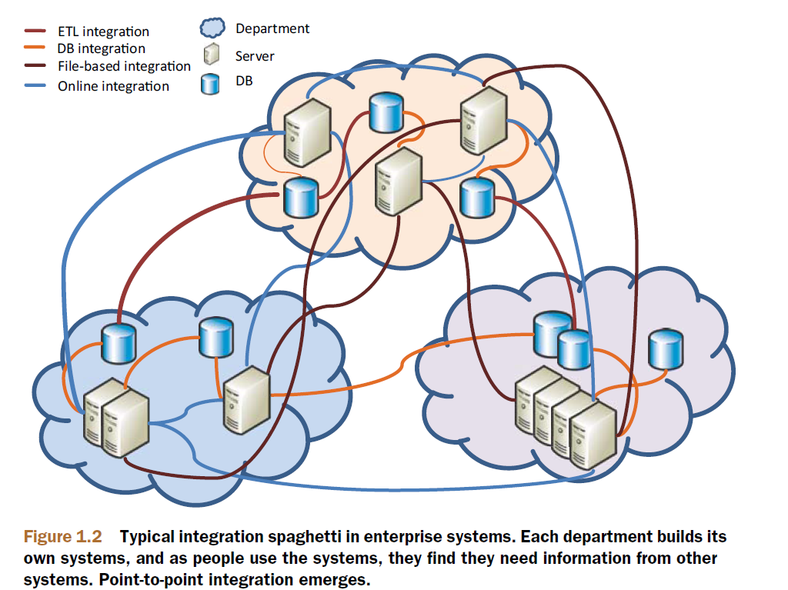
SOA Design Patterns – Why needed?

Slide 7
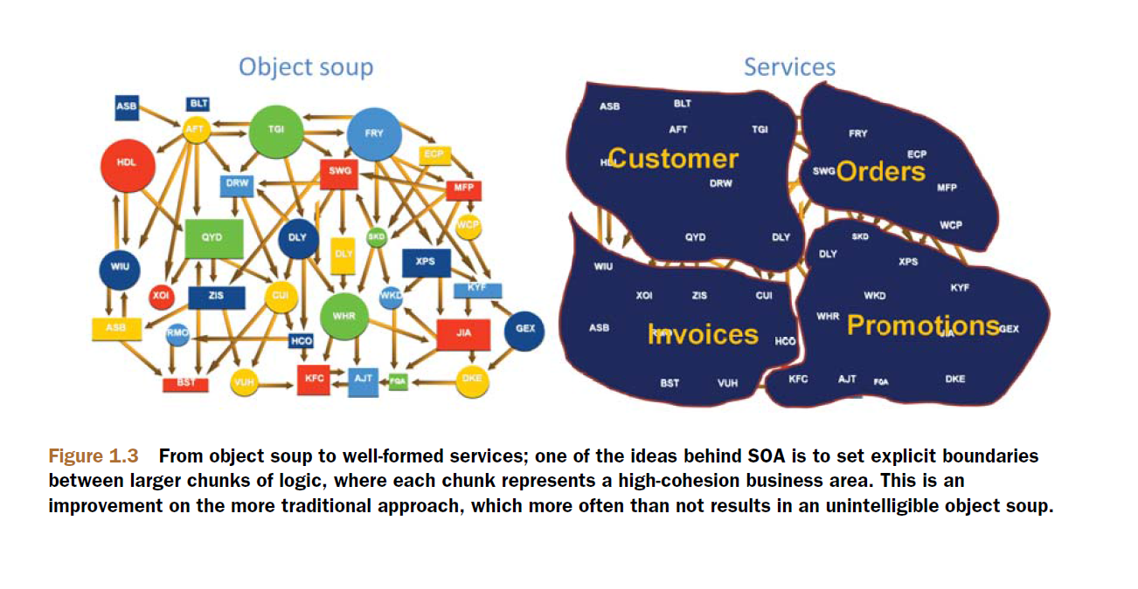
SOA Design Patterns – Why needed?

Slide 8
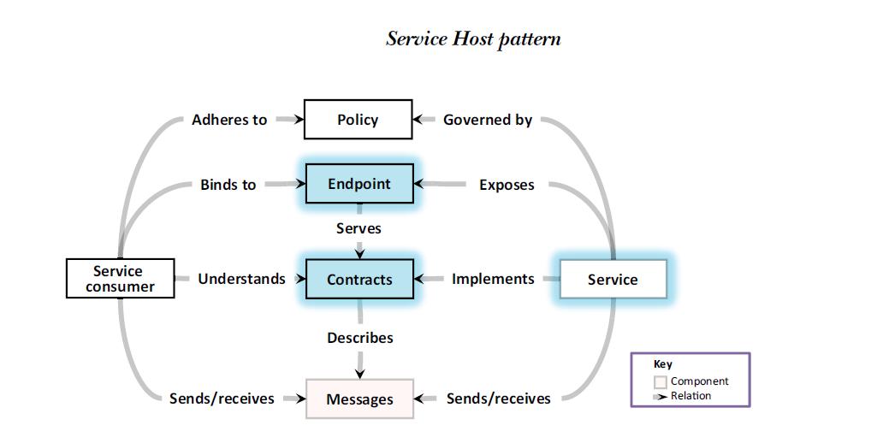
SOA Design Patterns – Service Host

Slide 9
SOA Design Patterns – Service Host
How can you easily configure services and avoid duplicating mundane tasks, such as setting listeners and wiring components, for each service?
SOLUTION
Create a common service host component or framework that acts as a container
for services. This container should be configurable and will perform the wiring and
setup of services.
The Service Host, illustrated in figure 2.2, is a framework or a complete component
that performs some or all of the following functions:
○ Lifecycle—Takes care of instantiating services, recycling services on fault, inplace
upgrades, and so on
○ Configuration—Reads and applies configuration to hosted services, including
configuration for security, contract policies, and ports
○ Wiring—Performs runtime setup of component wiring such as binding a listener
on a service’s endpoint
○ Administration—Lets an administrator control the lifecycle of a hosted service
and may also include monitoring capabilities (this is an additional layer on top
of lifecycle responsibility)
○ Environment—Provides auxiliary services like logging, cache, database libraries
(ODBC/JDBC), scheduler, and so on

Slide 10
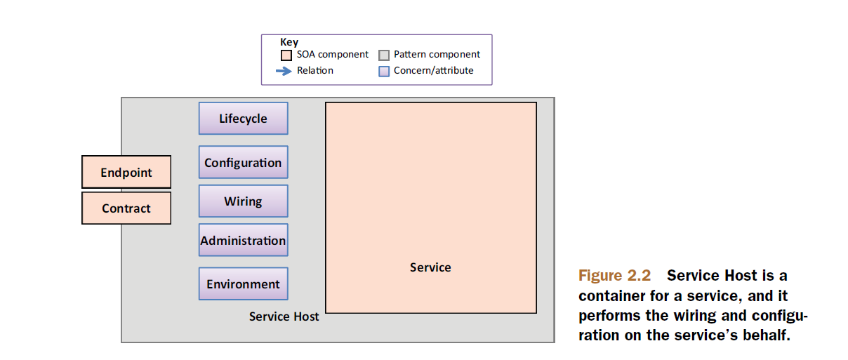
SOA Design Patterns – Service Host

Slide 11
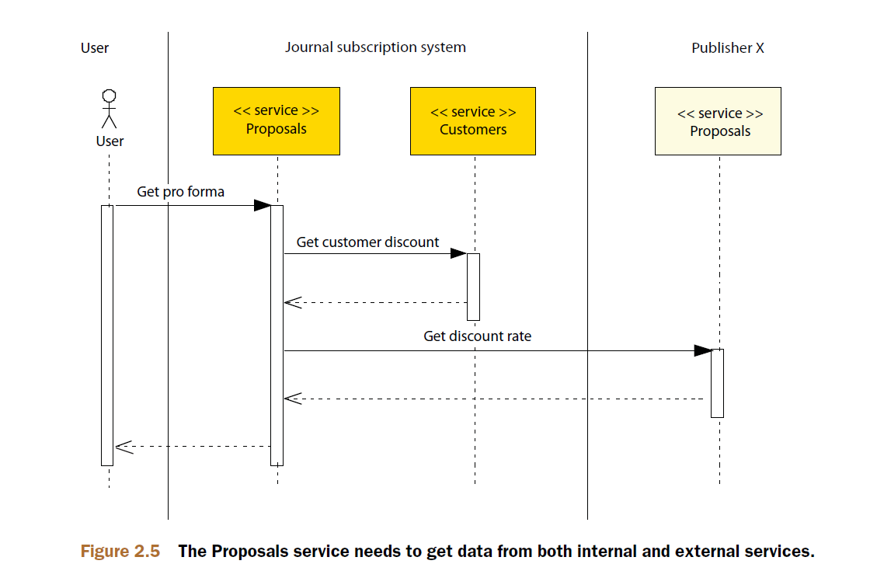
SOA Design Patterns – Active Service
Problem:
How can you increase service autonomy and handle temporal concerns?

Slide 12
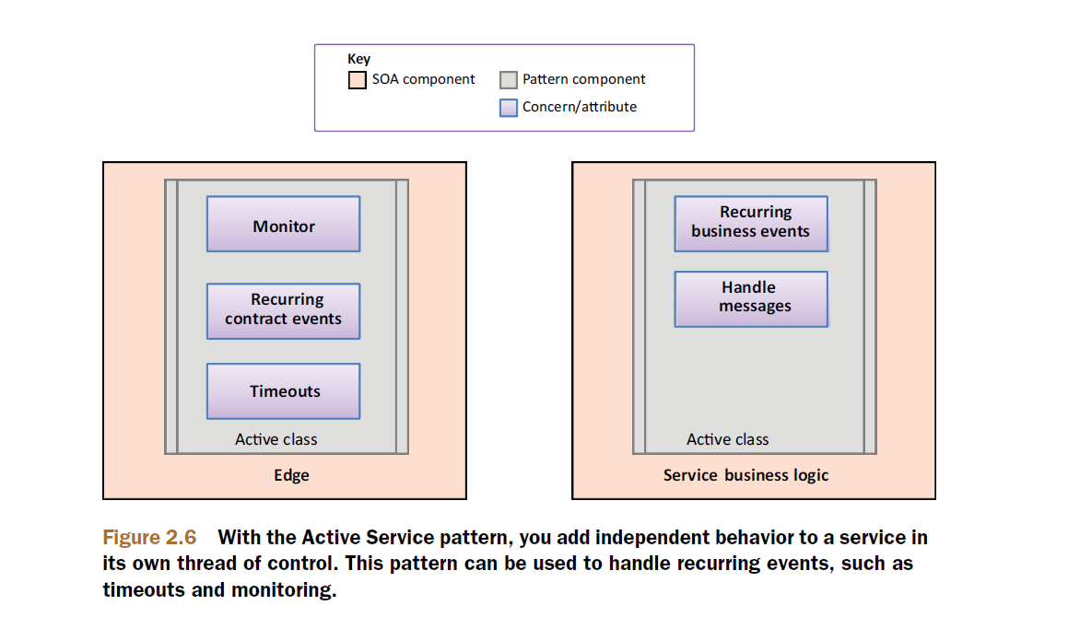
SOA Design Patterns – Active Service

Slide 13
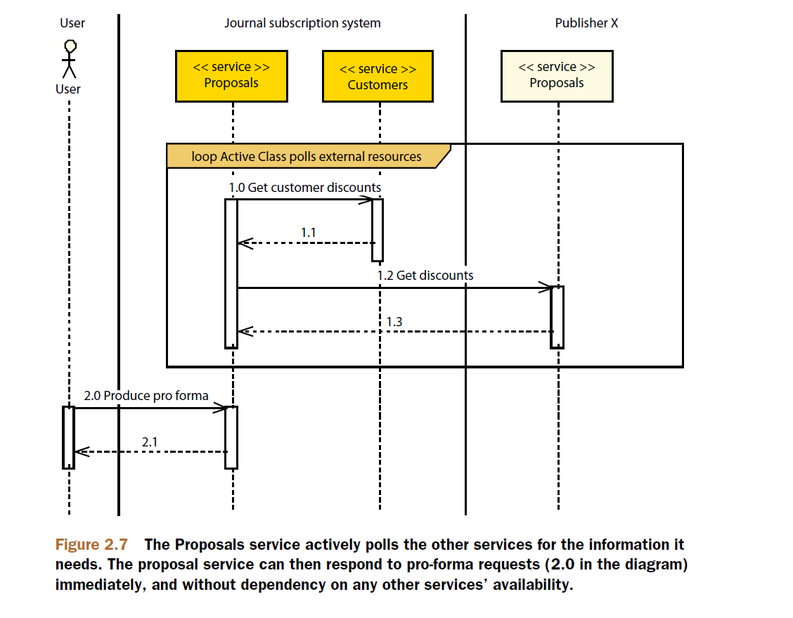
SOA Design Patterns – Active Service

Slide 14
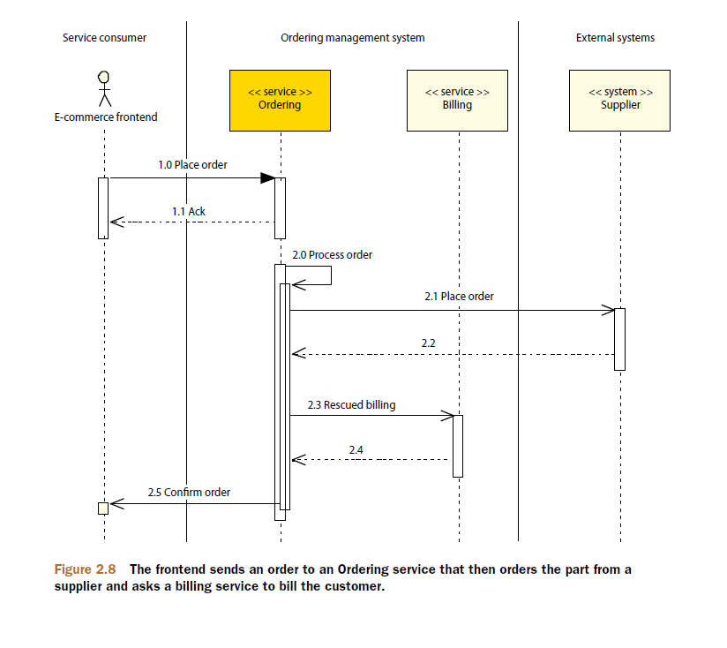
SOA Design Patterns – Transactional Service Pattern
Problem: How can a service handle requests reliably?

Slide 15
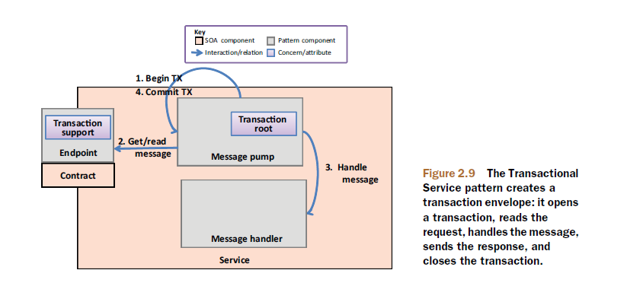
SOA Design Patterns – Transactional Service Pattern
SOLUTION
Apply the Transactional Service pattern to handle the entire message flow, so that
everything from receiving a request message to sending out a response is
contained in a single transaction.

Slide 16
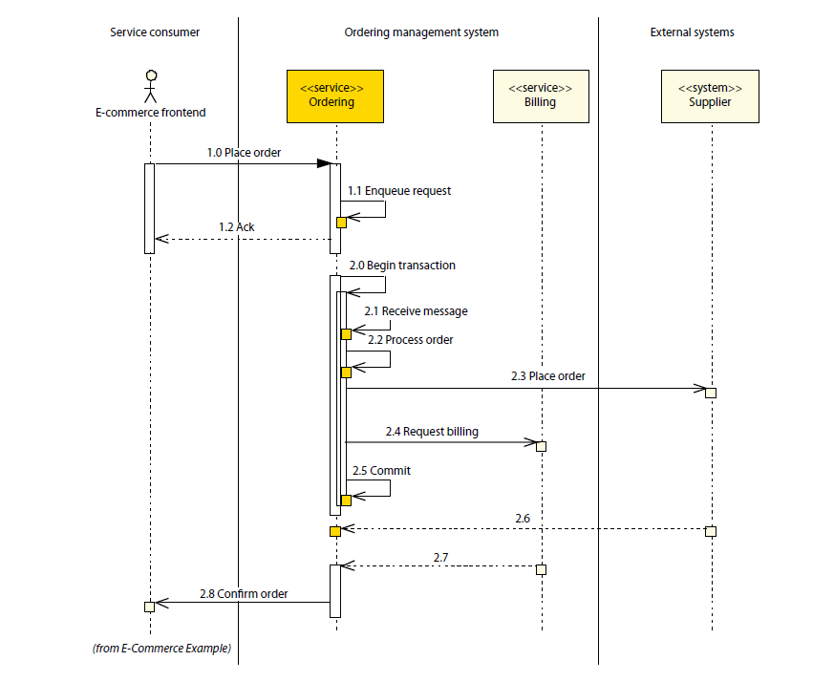
SOA Design Patterns – Transactional Service Pattern

Slide 17
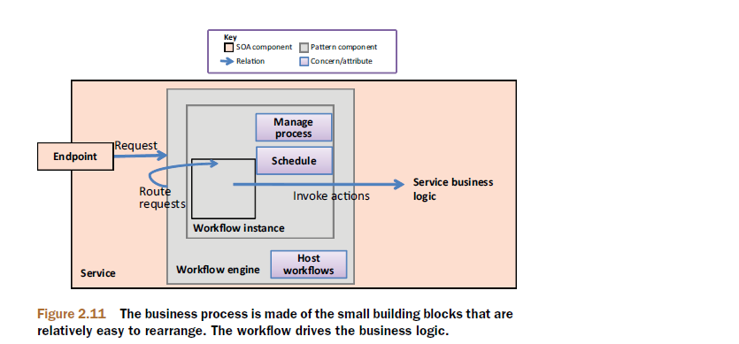
SOA Design Patterns – Workflow Service Pattern
Problem: How can you increase a service’s adaptability to changing business processes?
SOLUTION
Introduce a workflow engine within the service to handle the volatile and changing processes and orchestrate the stable logic.

Slide 18
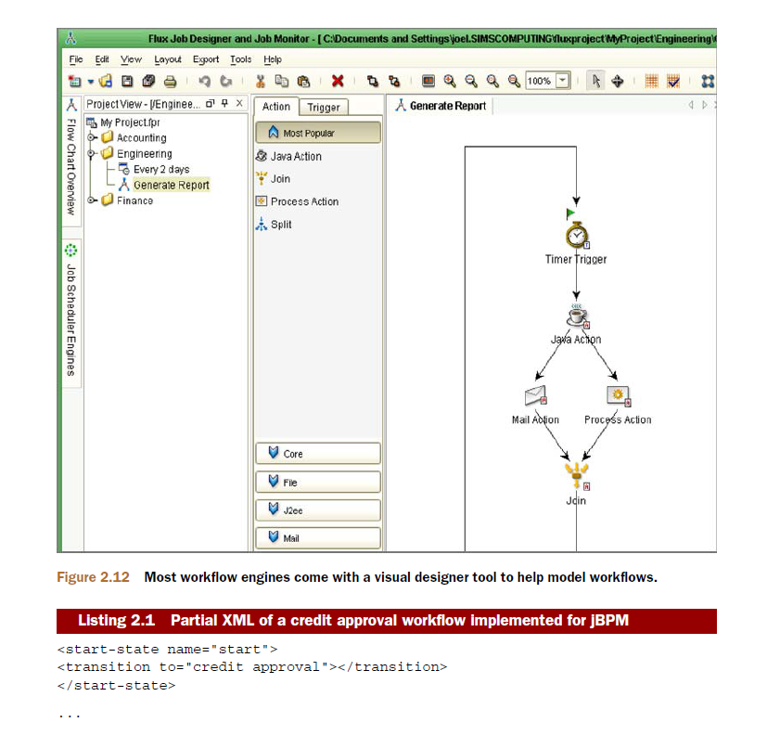
SOA Design Patterns – Workflow Service Pattern

Slide 19

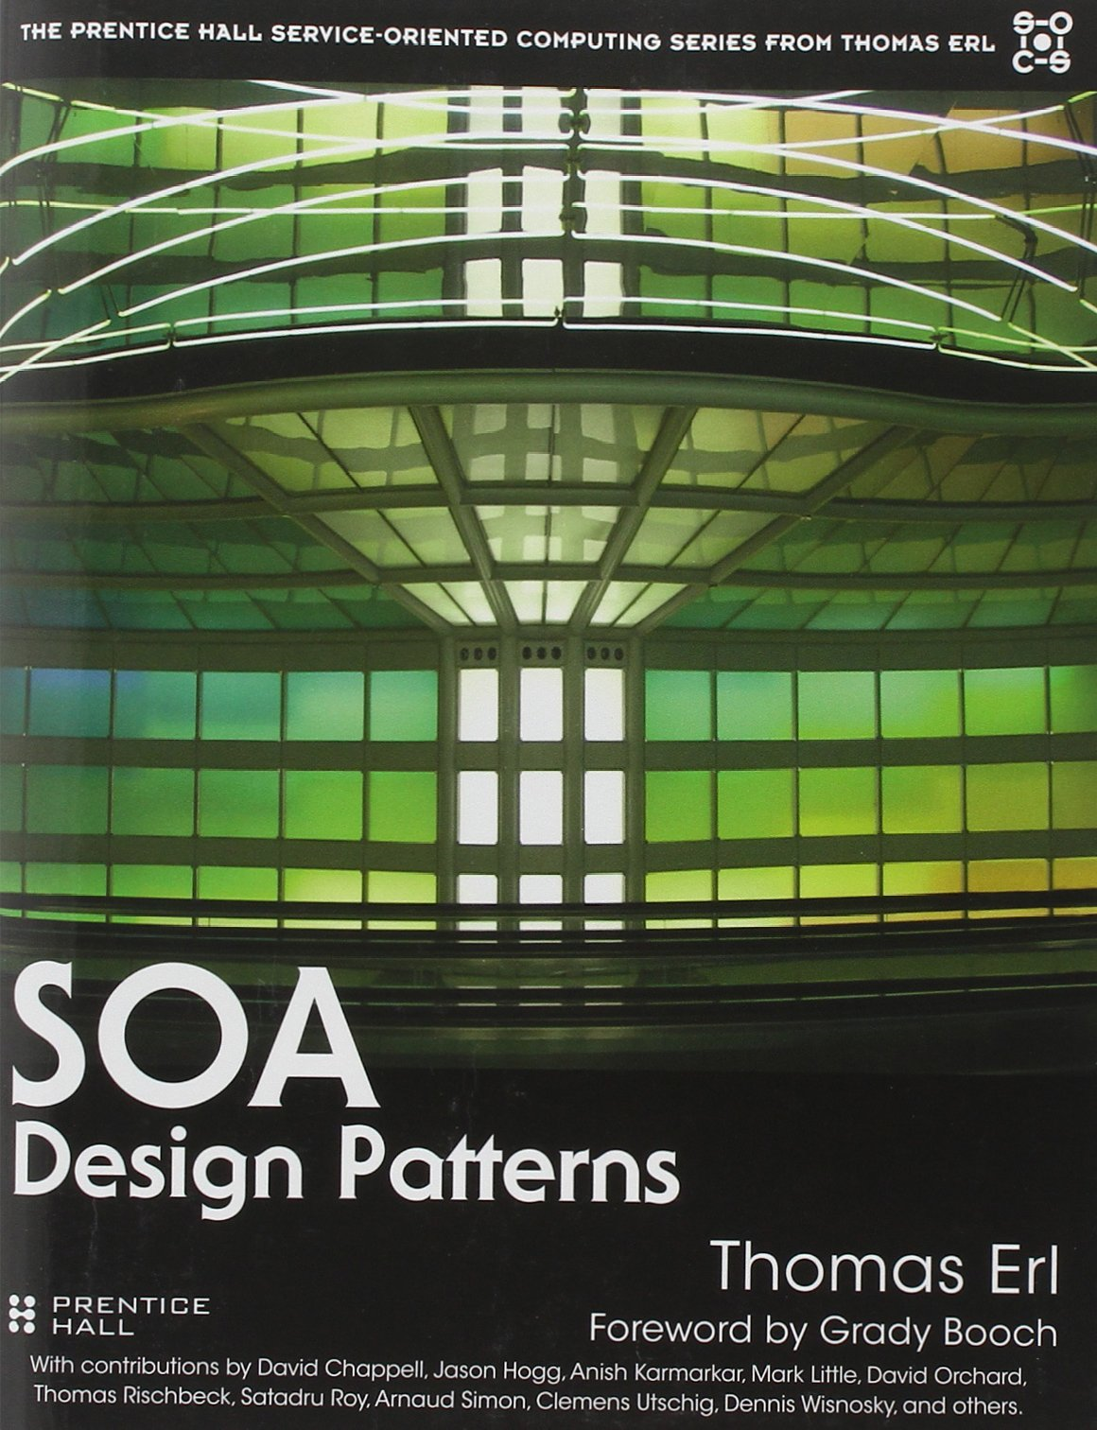
SOA Design Patterns

